Slide 1


SAP S/4HANA CDS, SAC Training Day 4
Anubhav Oberoy

Slide 2

Agenda – Day 4
Optimization for SQL Script in AMDP
CDS Table function
CDS hierarchy
--break
Currency Conversion and SAP Analytics Cloud
Cloud Connector
Connect BAS with S/4HANA
--break
Understand OVP Fiori App
Use case to implement OVP
Notes:
https://unsplash.com/photos/CPs2X8JYmS8

Slide 3

Arrangement
Fiori App
Analytic Tools
Third Party
API Consumer
Consumption views
Consumption views
@Analytic.query
Interface composite views
Interface Composite views
#CUBE
Basic interface views
Basic interface views
Basic interface views
Private views
Private views
DB Tables
DB Tables
DB Tables
DB Tables
DB Tables
DB Tables
DB Tables
9
www.anubhavtrainings.com

Slide 4





































Slide 5

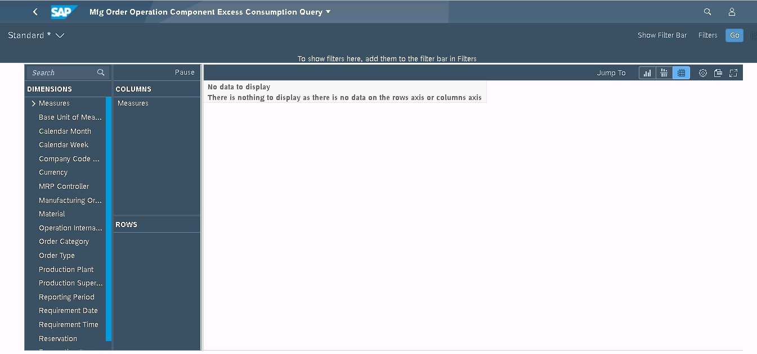
Query Browser
The Query Browser is an SAP Fiori application that you use to quickly and easily search for, browse, and tag the analytical queries. This application displays all the authorized analytical queries and customer queries to which the user has access. To launch the application, choose Query Browser from the Query Browser catalog. By default, the content views are pre-organized by the view name.
https://122.162.240.164:44330/sap/bc/ui2/flp#Shell-home

Slide 6

Use Case
We have business partner data of multiple counties displayed on the BUPA view. We want to secure this data, we want also row level security. That a manager who is working in US can only see USA customers hence a manager in Japan must only see the Japanese customers.
User
CDS DCL
Auth Class
1..*
Role
Auth Objects
Profile
1..*
Auth Fields
value
9
www.anubhavtrainings.com

Slide 7
Steps
Transaction code SU20 and define an authority field since we want to control permissions based on Country we will use the field as Country. - ZCTRY_APR
Go to transaction SU21 and create a authority class (ZBUP) and authorization object (ZAPR_BUPA).
We add the authority field to the object and a new filed ACTVT with type as 03
Open tcode pfcg and create a new role - ZAPR_BR_CDS_BUPA
9
www.anubhavtrainings.com

Slide 8
SQL Script Rules
It is not case-sensitive
Every statement ends with semi-column ( ; )
If we create a variable and do not assign any value to it, a null gets assigned and any operation with NULL produce a null
When we create a variable and assign a value we can do it directly with variable name
When we use a variable inside an operation we use the value of (:)
We create variables using DECLARE statement in SQL Script (in ABAP we use data)
In SQL Script = is a comparison operator but := is the assignment operator.
DECLARE x integer;
DECLARE y integer;
DECLARE z integer;
x := 10;
Y := 20;
Z := :x + :y;
In SQL Script everything evolves around SQL so even we need to print data we use SELECT var FROM dummy;
DUMMY is a dummy table provided by SAP to just print data in output
Data types for creating variables
Number – integer, BIGINT, Decimal, TINYINT
Char – CHAR, VARCHAR, NVARCHAR
Special – BLOB, CLOB
Date – DATE, TIMESTAMP, DATETIME
9
www.anubhavtrainings.com

Slide 9


AMDP – ABAP Managed Data Procedure
AMDP is an object created in ABAP system and at runtime it generates the procedure in HANA system hence we achieve code to data paradigm. It is one of the best technique to push down logic to the database. There is no need to login to HANA database anymore using HANA Studio as we can directly write SQL Script logic in ABAP system. Internally it contains SQL Script logic.
An AMDP is a ABAP class which contains SQL Script logic mutated by using an interface if_amdp_marker_hdb
An AMDP is a static method inside of a class
The class can contain both ABAP and AMDP method but we cannot merge abap code
The class gets capability to do syntax check for sql script code
The AMDP method cannot have changing and return parameter
We have passed all values pass by value, if you plan to use tables in AMDP you must define them with using clause
We cannot use complex data types like deep structures
We have to also use a special syntax for defining AMDP method
An AMDP is managed by ABAP system, hence it is sufficed to use ABAP transport to send to Q and P
When we activate AMDP nothing happens, when your call the AMDP that’s when the procedure gets created in HANA
Peter parker
Spiderman
Mutation
IF_AMDP_MARKER_HDB
9
www.anubhavtrainings.com

Slide 10

OIA Scenario – Based on EPM Model
Open Item Analysis Scenario
Mr. Jems is 65-year-old men, working in ITeIO company since last 25 years as an account receivable accountant. He drives Audi A8 and lives in downtown in his own house near the lake. He loves reading books and do gardening.
Who is an Account Receivable Accountant?
Cash has a very important role for the success of the business. It is in the best interest of a company to collect the pending dues from their customers on time. By putting this cash back into the system company can execute their expansion plans and perform better for profitability in the future. An accountant’s job is to look into the system and find out all the unpaid invoices. He typically comes into the office and look for invoices are pending since long time and exceeds a particular threshold. Classify these invoices and perform dunning (contact customers).
9
www.anubhavtrainings.com

Slide 11
Takt Plan
Store the threshold levels inside a customizing table for the user – ZDP_CUST
How long the invoices are due on average days basis
Invoices which are unpaid by the customers – SNWD_SO_INV_HEAD where Payment_status = ‘’
Calculate the average no. of days since when every invoice is pending for each customer (Today – When was changed)
We will calculate average = Total (How many days all invoices are due) / Count (Count of invoices)
e.g. total 4 invoices due as 10,20,30,5 = 10+20+30+5 / 4
Join this with the customer master SNWD_BPA
3. Calculate the total due amount in common currency
1. Find the open invoices which are due SNWD_SO_INV_HEAD , Payment_Status = ‘’
2. get the items for each due invoice and its amount with currency code – SNWD_SO_INV_ITEM, CONVER_TO_CURRENCY
3. Convert the amount to a common currency which we can read from the Customizing table
4. Total due amount and join with Customer Data
4. Compare the open days and open amount with the threshold, if yes, we will tag the customer.
Takt1
Takt2
9
www.anubhavtrainings.com

Slide 12
More Questions
How to debug an AMDP
https://www.youtube.com/watch?v=fpXoTqHLeSo
How to call one AMDP inside another AMDP
https://youtu.be/r2LsDROiJ90
Can you show one more real time scenario in AMDP like FOR ALL ENTRIES in ABAP
https://youtu.be/Tm1RFOt0KMY
https://youtu.be/dIMPMNlT7jQ
How to do performance analysis on AMDP
https://youtu.be/KLgTI1J5d3E
Can we add AMDP method and also normal ABAP method in same class
https://youtu.be/1JkX-XuSeVE
How to implement selection-options with AMDP
https://youtu.be/hbtnWi032Z8
9
www.anubhavtrainings.com

Slide 13
Optimization for SQL Script in AMDP
--Q1
lt_products = select prod_id from products WHERE type = ‘WebCAM’;
--Q2
lt_so = select * from sales WHERE pid in ( select prod_id from lt_products );
--Q3
lt_po = select * from pruc WHERE pid in ( select prod_id from lt_products );
--Q4
lt_so = select sum(amount), comp_code from lt_so;
When will hana come out of parallel mode
Whenever a DDL/DML statement is executed
Whenever the result is not assigned to implicit table
Any declare statement is detected
Any imperative logic like loop, if etc.
Rules:
Write all DML/DDL/Processing logic at the end of all code.
Split code in different AMDP.
9
www.anubhavtrainings.com

Slide 14
CDS Table function
Is a new feature introduced in SAP NW 7.5 onwards to enrich the CDS concept. It allows following
We can integrate SQL script code with CDS views
We can overcome the limitations and disadvantages of cds views
We can call an AMDP using CDS
Helps to eliminate the type conflict issues with cds
Allows to integrate the complex logic with cds views
We can reuse the cds table function in another cds view with associations and joins
A cds table function is just like AMDP which can be used to integrate the SQL Script logic. But behind the scenes it will create a Table UDF in HANA. A CDS table function
Will contain a CDS definition, which will act like skeleton of the output data
But eventually it will invoke a class function which contains SQL script code
This SQL script code can call AMDP, pure SQL script logic
Use Case
Once upon a time in Mumbai, I was working on a project there was a requirement to convert an ABAP report to CDS view. This report was joining but000 (customer master) table with crmd_partner (crm partners)
9
www.anubhavtrainings.com

Slide 15
Hierarchy
A hierarchy is a tree data-structure. A tree is composed of nodes. These nodes can be root node (top most), parent node, and child node. A hierarchy in ERP represent our business data as a TREE data structure.
Why?
It is a better representation of data in form of nodes
We can easily identify the relationship between data
It is also useful for visualization
Easy to traverse the data
ERP is full of hierarchy
Employee-manager hierarchy
Org structure
Cost Centre hierarchy
Profit Centre Hierarchy
There are 2 ways to build hierarchy in CDS views
New Hierarchy
Classic hierarchy
9
www.anubhavtrainings.com

Slide 16


































































Slide 17
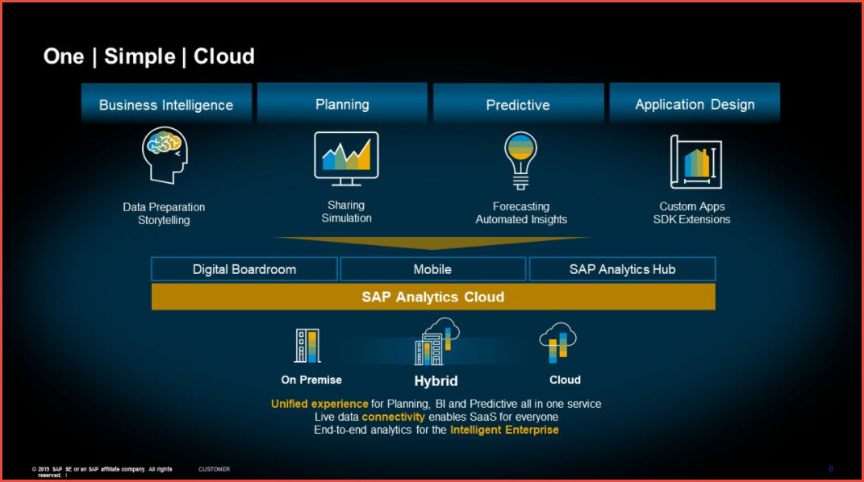
SAP Analytics Cloud
SAP Analytics Cloud brings together analytics and planning in a single solution in the cloud. You can instantly move from insight to action, simulate any scenario for better business outcomes, and generate plans from predictions automatically to drive agile decisions.

Slide 18

Basics of Connectivity and Role of SCC
Internet
Intranet
SAP BW
SAP ECC
SAP S/4 Hana
SAP BTP (PublicCloud)
SAP Cloud Connector
SAP On-premise System
SAP Business Application Studio
SCC
Destination
S/4 Hana Cloud
Field Glass
Sales Force

Slide 19
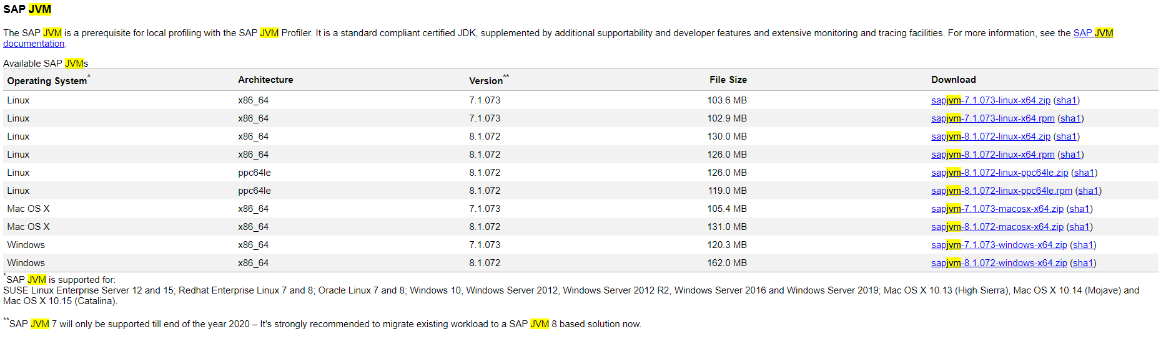
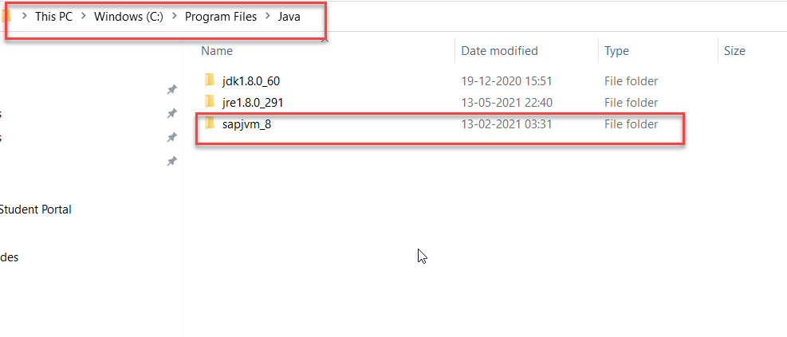
Cloud Connector
Step 1: Download SAP JVM and Extract it in the C:\Program Files\Java

Slide 20
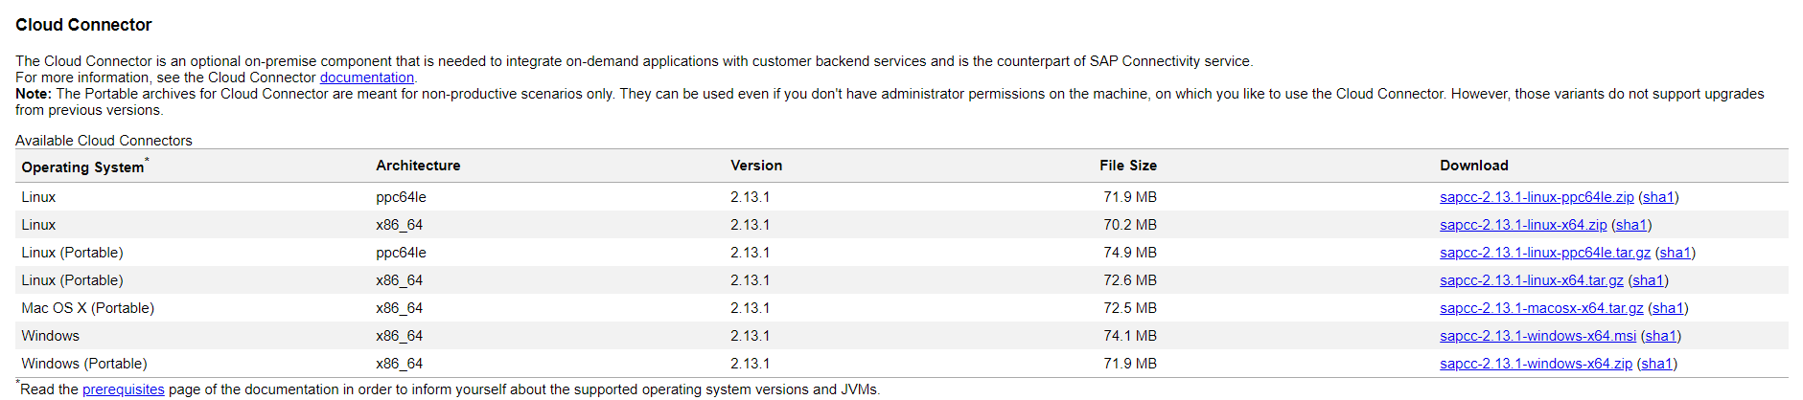
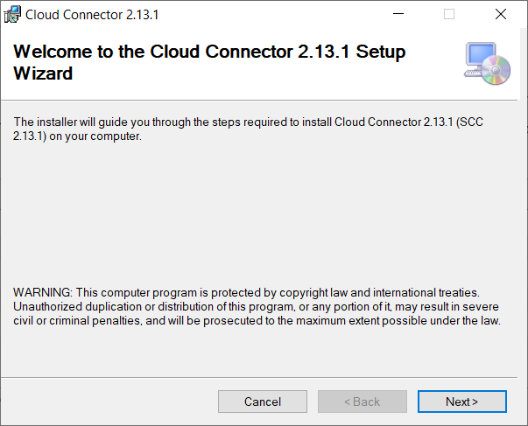
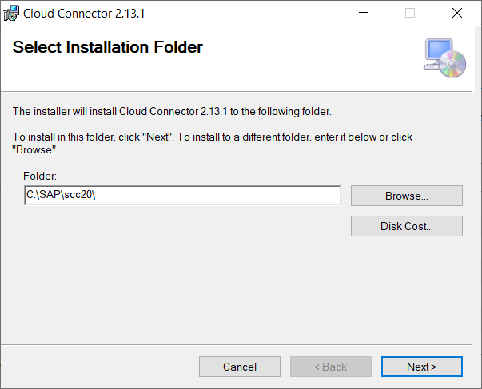
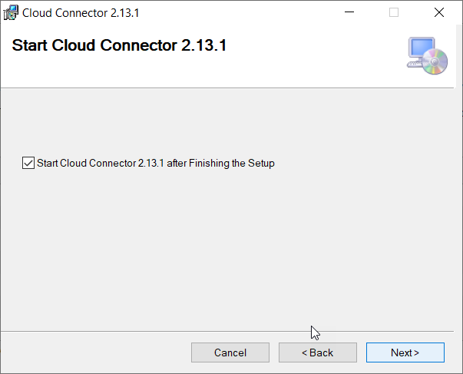
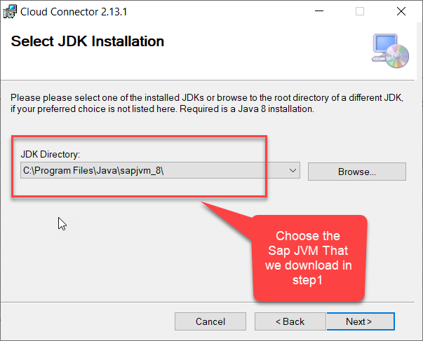
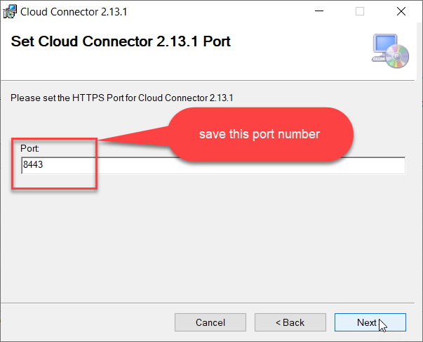
Cloud connector continue…
Step 2: Download and install the sap Cloud connector

Slide 21
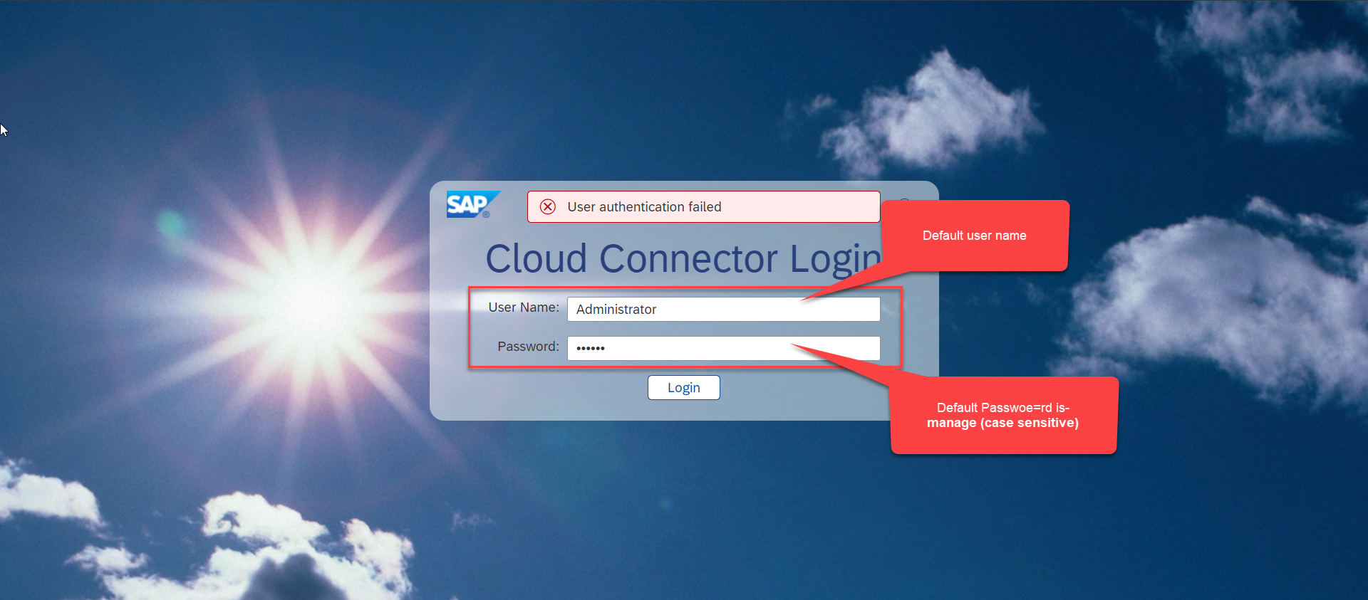
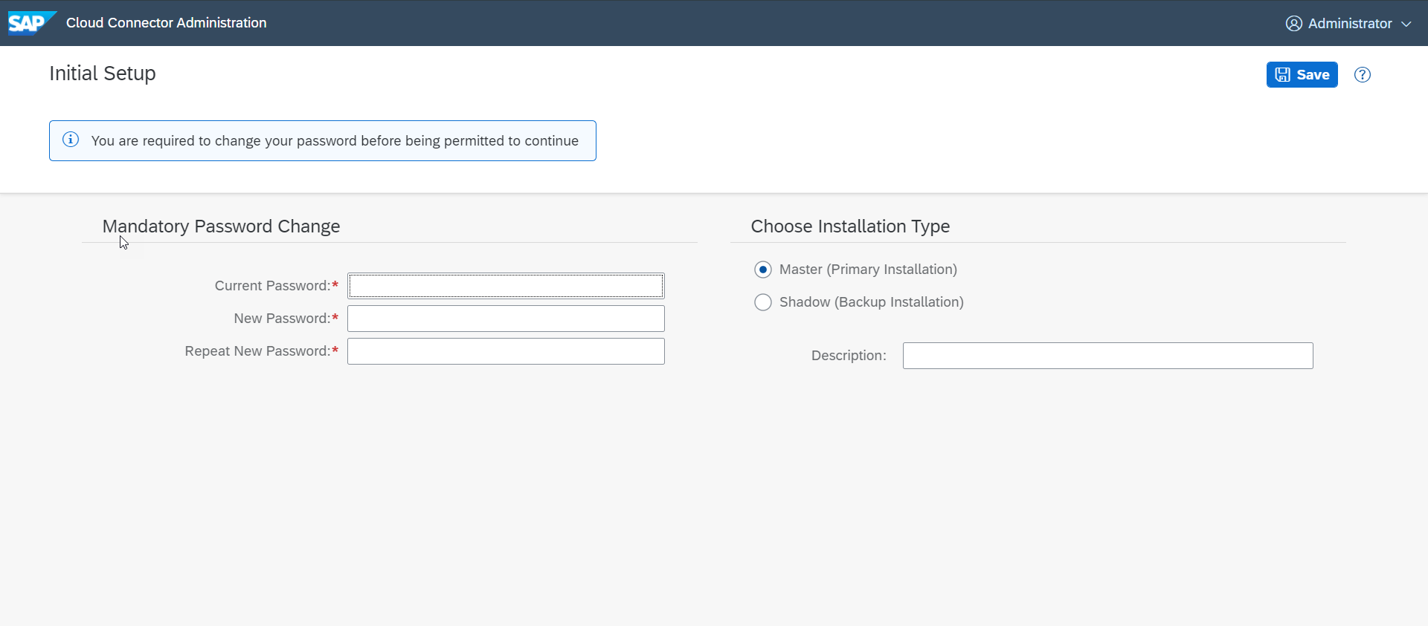
Cloud connector continue…
Step 3: Now your system is ready go to browser and open https://localhost:8443 (port may changes)
The default credentials are Administrator / manage

Slide 22
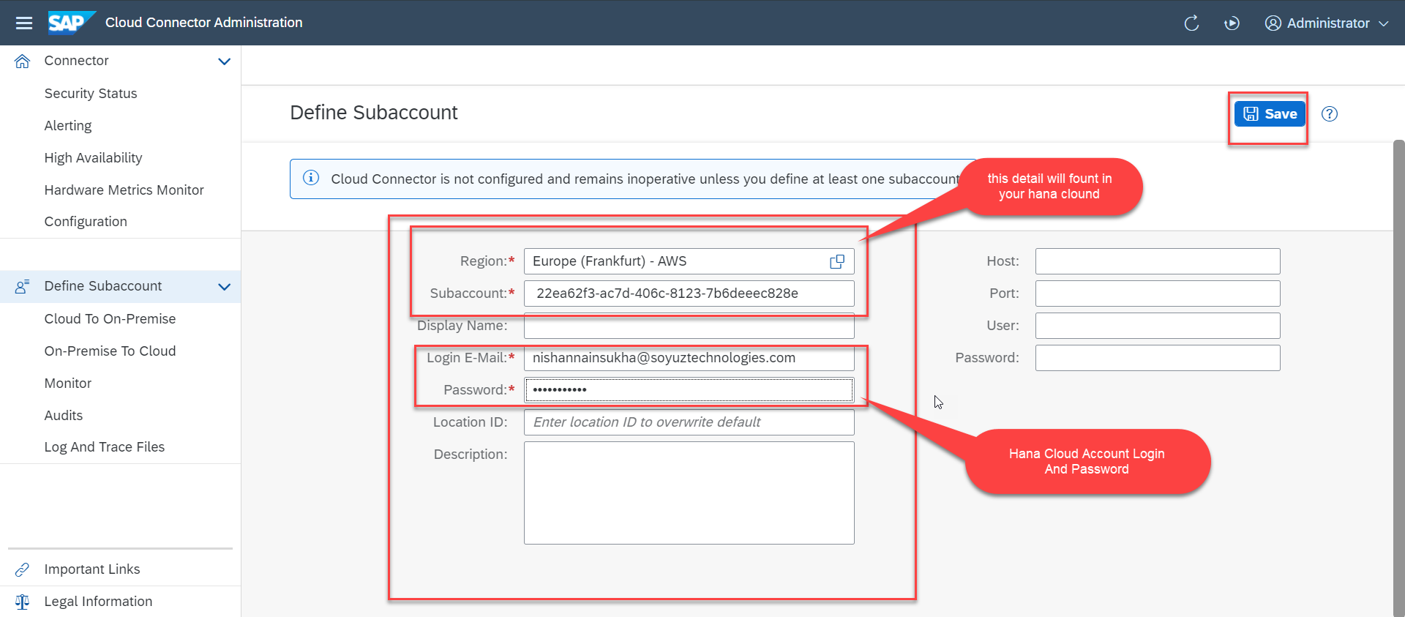
Cloud connector continue…
Step 4: Now we create a connection with our Cloud Account

Slide 23
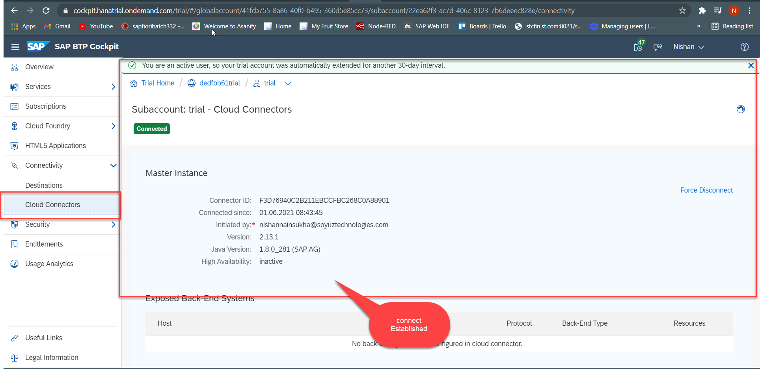
Cloud connector continue…
Step 5: Check the connection on Hana Cloud Account

Slide 24
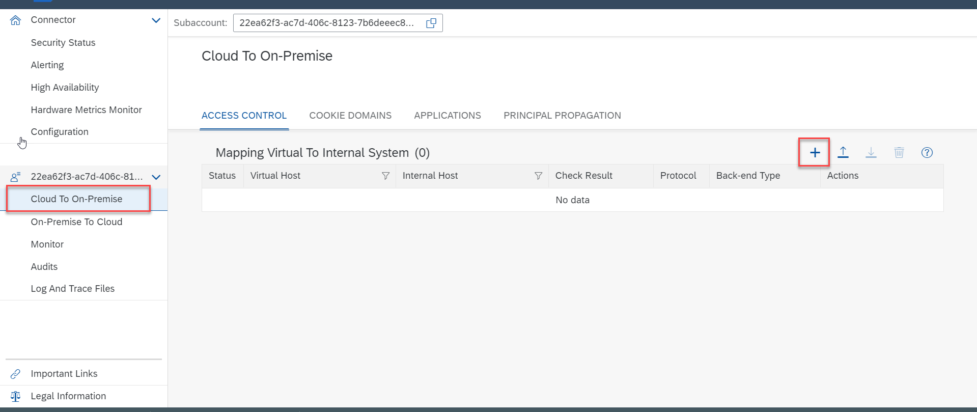
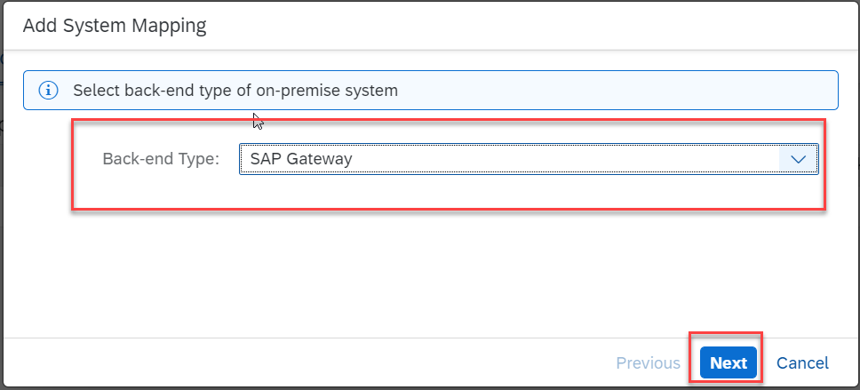
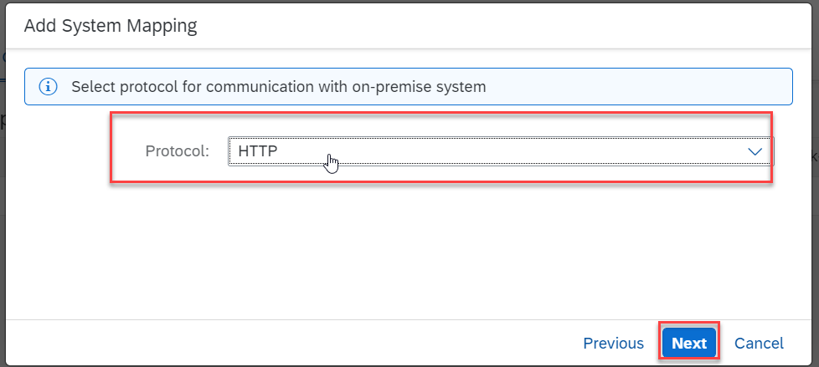
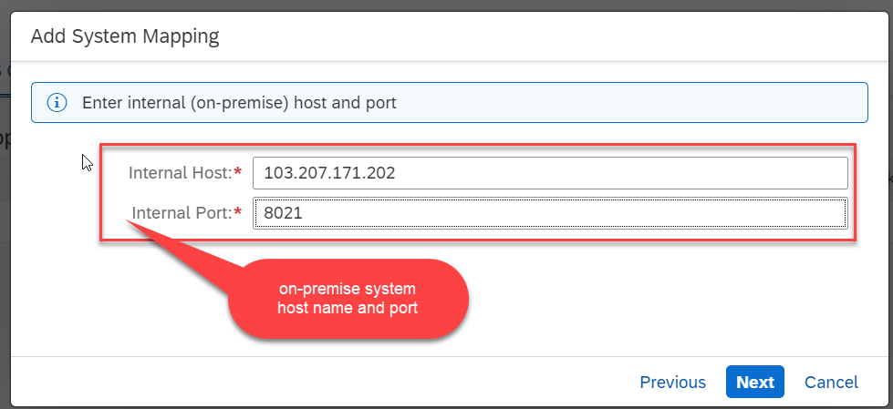
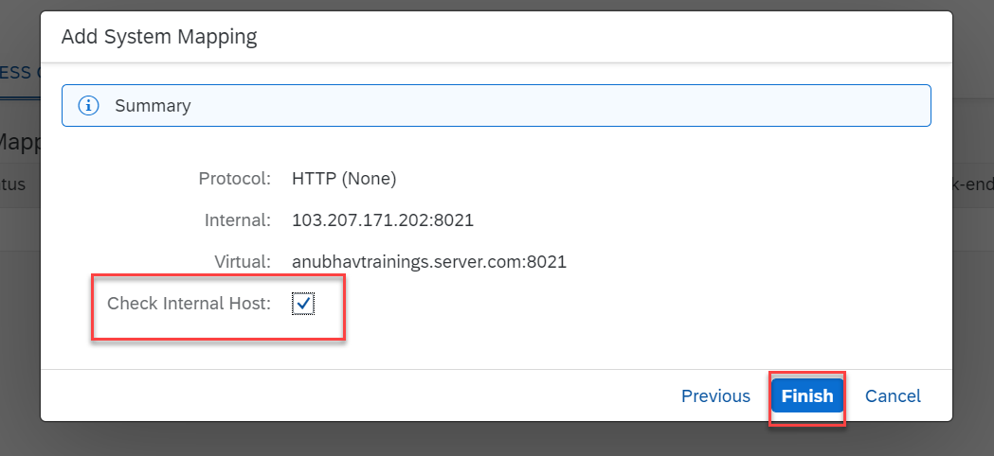
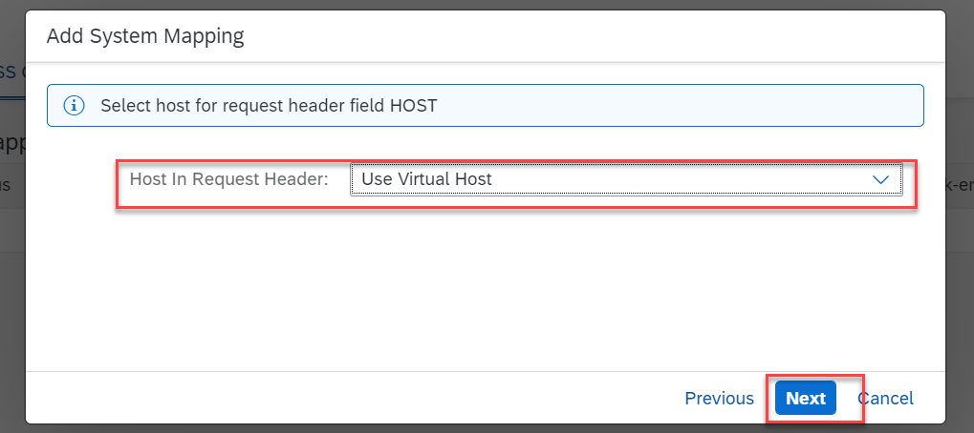
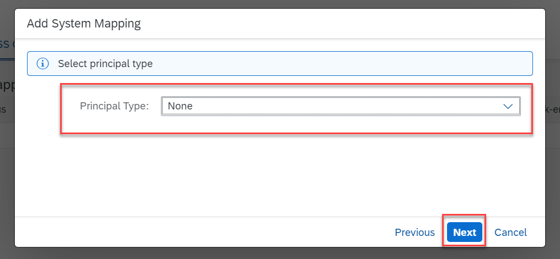
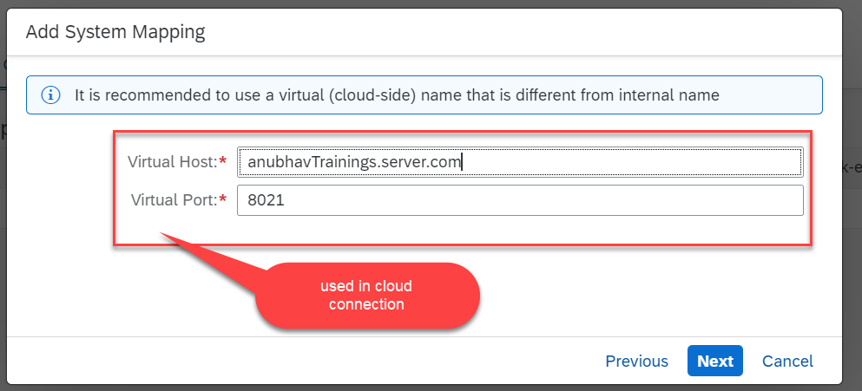
Cloud connector continue…
Step 6: Connect on-premise system to cloud using SCC

Slide 25
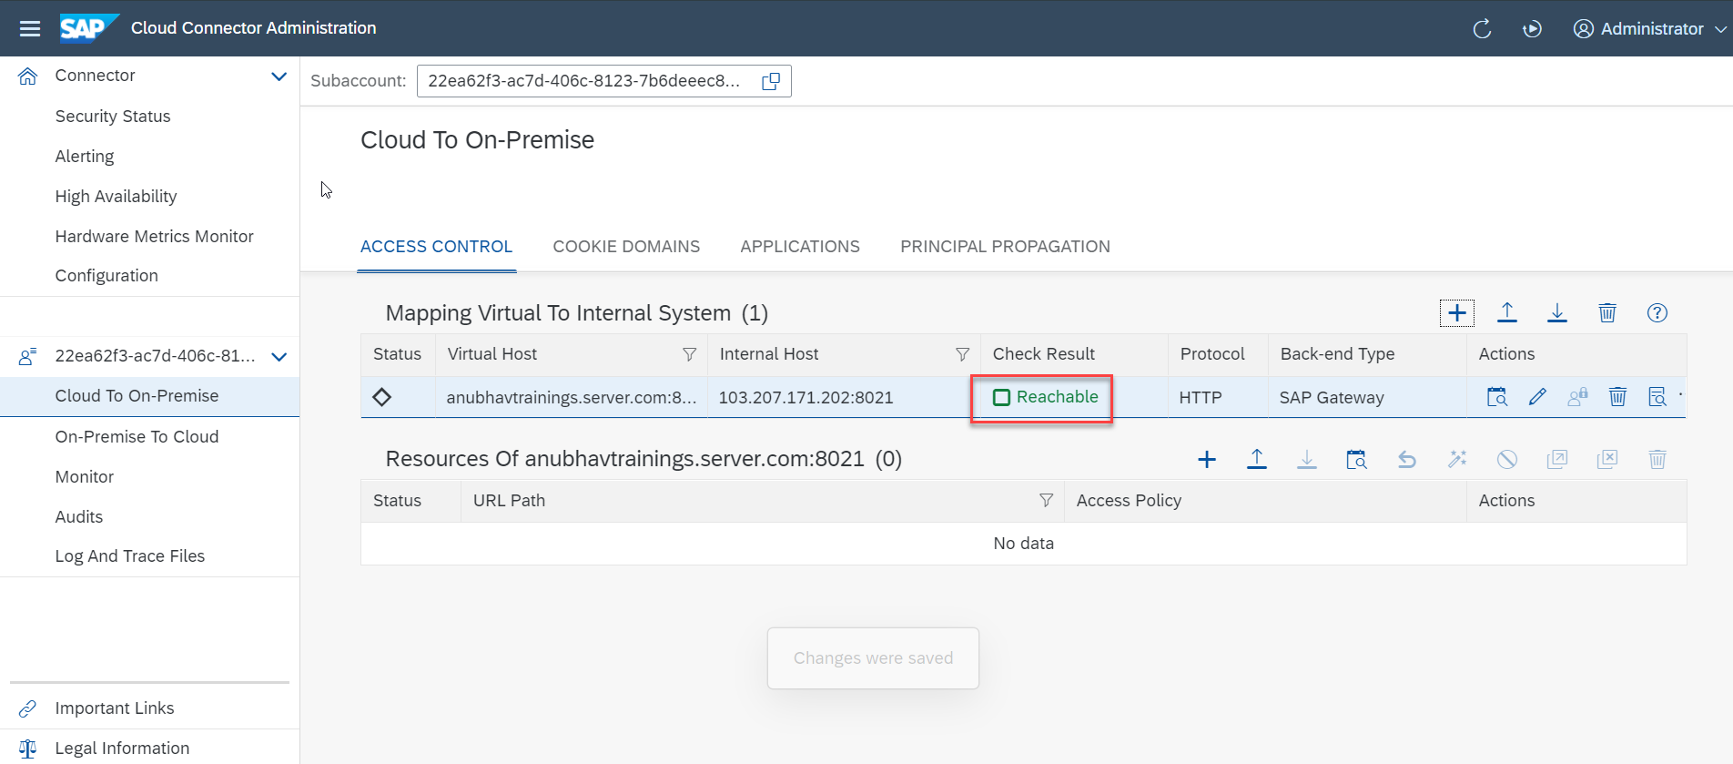
Cloud connector completed
We have Done with Connect , now we are now successfully connected to cloud using SCC.

Slide 26
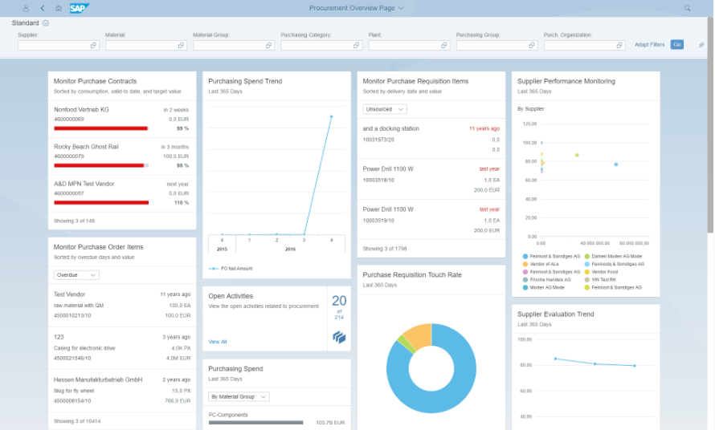
OVP Applications in S/4HANA
The overview page (OVP) is a data-driven SAP Fiori app type and floorplan that provides all the information a user needs in a single page, based on the user's specific domain or role.

Slide 27
Title
Text

Slide 28
Title
Text

Slide 29

Questions?

Slide 30

Thank you
Anubhav.abap@gmail.com
contact@anubhavtrainings.com
+91 84484 54549
www.anubhavtrainings.com

